Slide 1
Design Considerations for High Throughput Cloud-Native Relational Databases
Amazon Aurora
讲者： 郭华

Slide 2
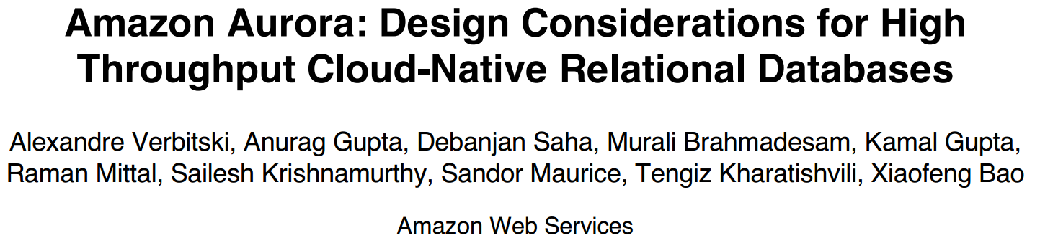
SIGMOD 2017 Paper

Slide 3
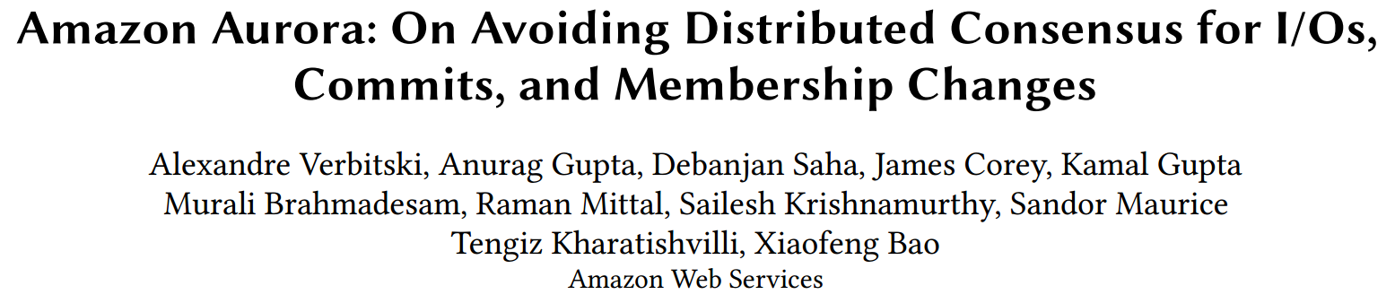
SIGMOD 2018 Paper

Slide 4
What Is Amazon Aurora ?

Slide 5
What Is Amazon Aurora ?
Aurora is a relational database as part of Amazon Web Services especially designed for high throughput workloads
Reimagining Databases for the Cloud
Speed and availability of high-end commercial databases
Simplicity and cost-effectiveness of open source databases
Drop-in compatibility with MySQL and PostgreSQL
Simple pay as you go pricing
Delivered as a managed service

Slide 6
Aurora’s Motivation
Game changes in the Cloud
Resource is on demand in the cloud
Throughput is highly important
Resilient to failure
Traditional design of database is not desirable
Too many synchronous points
Chain replication
Replicated Block Device
High overhead in network I/O
Trouble with commits on synchronization protocols
Two-phase commit protocol is challenging

Slide 7
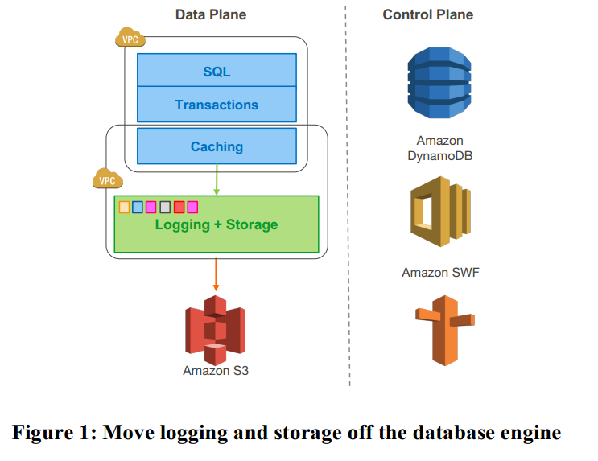
Scale-out, Distributed, Multi-Tenant Architecture
Scale-out, distributed, multi-tenant design
Service-oriented architecture leveraging AWS services
Fully managed service – automate administrative tasks

Slide 8
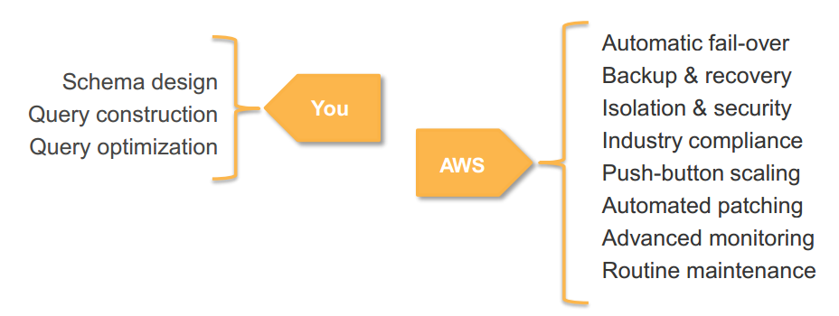
Automate administrative tasks
Takes care of your time-consuming database management tasks, freeing you to focus on your applications and business

Slide 9
Availability && Performance

Slide 10
Quorum-Based Voting
Quorum-based Voting Protocol D.K. Gifford. Weighted voting for replicated data. In SOSP 1979
Vr + Vw > V
Each read must be aware of the most recent write
Ensures the set of nodes used for a read intersects with the set of nodes used for a write
The read quorum contains at least one location with the newest version
Vw > V/2
Each write must be aware of the most recent write to avoid conflicting writes

Slide 11
2/3 Quorums Are Inadequate
On a ﬂeet-wide basis, it is insufficient to treat failures as independent.
At a minimum, it is necessary to consider the correlated impact of the largest unit of failure in addition to the background noise of on-going independent failures.
Availability Zone (AZ)
Subset of a Region that is connected to other AZs through low-latency networking links
Isolated for most faults
Including power, networking, software deployments, ﬂooding, and other phenomena

Slide 12
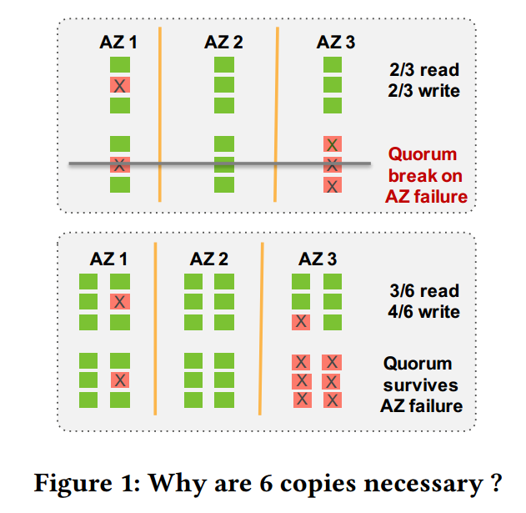
Why are 6 copies necessary?
In a large fleet, always some failures
AZ failures have “shared fate”
Need to tolerate AZ + 1 failures and still be able to repair
For 3 AZs, requires 6 copies

Slide 13
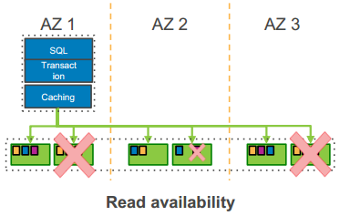
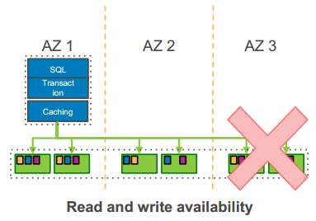
6-Way Replicated Storage
Six copies across three Availability Zones
4 out 6 write quorum
3 out of 6 read quorum
Peer-to-peer replication for repairs
Volume striped across hundreds of storage nodes

Slide 14
Aurora Performance Tenets
DO LESS WORK
Do fewer IOs
Minimize network packets
Cache prior results
Offload the database engine
BE MORE EFFICIENT
Process asynchronously
Reduce latency path
Use lock-free data structures
Batch operations together
DATABASES ARE ALL ABOUT I/O
NETWORK-ATTACHED STORAGE IS ALL ABOUT PACKETS/SECOND
HIGH-THROUGHPUT PROCESSING IS ALL ABOUT CONTEXT SWITCHES

Slide 15
Segmented Storage
Partitioning the database volume into small fixed size segments
currently 10GB in size
Each replicated 6 ways into Protection Groups (PGs)
each PG consists of six 10GB segments
organized across three AZs
provisioned as virtual hosts with attached SSDs
using Amazon Elastic Compute Cloud (EC2)
Segments are unit of independent background noise failure and repair
A 10GB segment can be repaired in 10 seconds on a 10Gbps network link

Slide 16
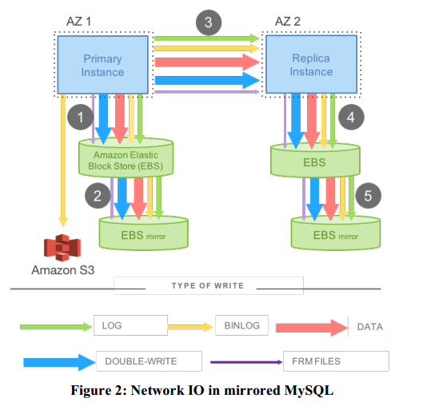
Network IO in mirrored MySQL
IO flow
Issue write to EBS – EBS issues to mirror, ack when both done
Stage write to standby instance using synchronous replication
Issue write to EBS on standby instance
OBSERVATIONS
Steps 1, 3, 4 are sequential and synchronous
This amplifies both latency and jitter
Many types of writes for each user operation
Have to write data blocks twice to avoid torn writes
PERFORMANCE
780K transactions
7,388K I/Os per million txns
Average 7.4 I/Os per transaction

Slide 17
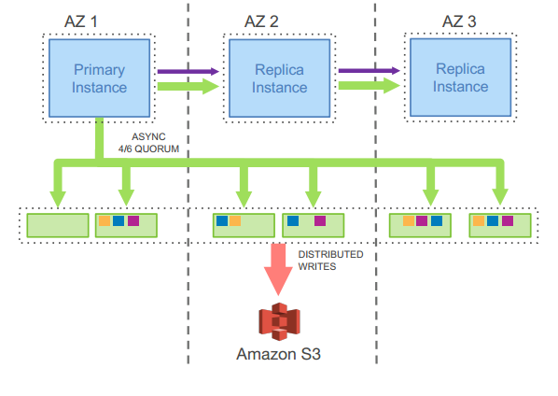
The Log is the Database
Lazy page materialization
Materialization when
Read for current pages
Frequent page change
The advantage of offloading redo logs
Keep processing redo log in the background.
Utilize CPU resource wisely when foreground is busy.
Fast recovery

Slide 18
Network IO in Amazon Aurora (Database Node)
IO FLOW
Boxcar redo log records – fully ordered by LSN
Shuffle to appropriate segments – partially ordered
Boxcar to storage nodes and issue writes
OBSERVATIONS
Only write redo log records; all steps asynchronous
No data block writes (checkpoint, cache replacement)
6X more log writes, but 9X less network traffic
Tolerant of network and storage outlier latency
PERFORMANCE
27,378K transactions 35X MORE
950K I/Os per 1M txns (6X amplification) 7.7X LESS

Slide 19
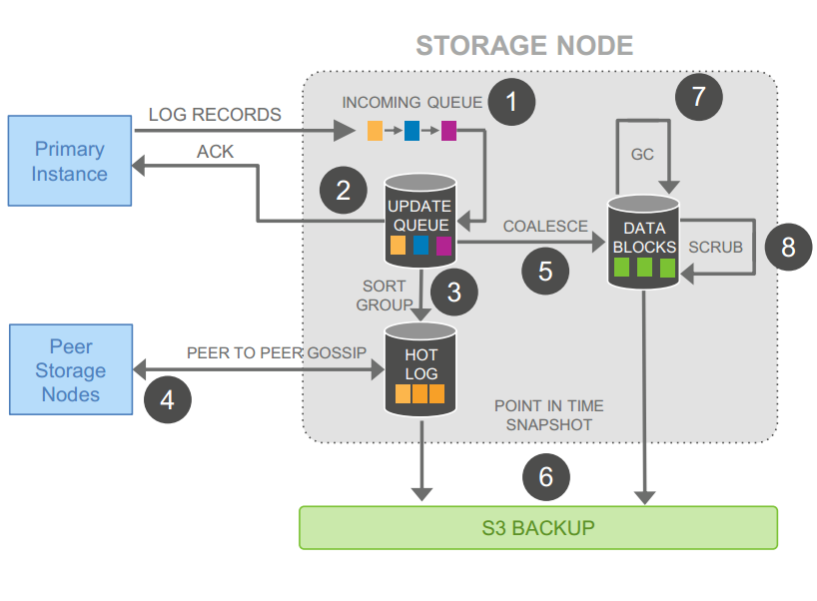
Network IO in Amazon Aurora (Database Node)
Functionality
1.Receive record and add to in-memory queue
2.Persist record and ACK
3.Organize records and identify gaps in log
4.Gossip with peers to fill gaps
5.Apply logs into new data pages
6.Periodically backup log and pages to S3
7.Periodically garbage collect old versions
8.Periodically validate CRC codes on blocks
Highly asynchronous
Only 1. 2. are synchronous
Other jobs are continuously running in the background
Minimize latency of write request

Slide 20
Points of Consistency and Durability
Log Sequence Number (LSN)
Each log record associates a monotonically increasing value generated by the database
Volume Complete LSN (VCL)
The highest LSN for which it can guarantee availability of all prior log records
During storage recovery, every log record with an LSN larger than the VCL must be truncated
Consistency Point LSN(CPL)
Constrain a subset of points that are allowable for truncation by tagging log records
Volume Durable LSN(VDL)
The highest CPL that is smaller than or equal to VCL
Truncate all log records with LSN greater than the VDL

Slide 21
Writes
Write quorum
Vw/2 > V
Advance the current VDL
Allocate a unique ordered LSN for each log record
LSN Allocation Limit (LAL)
LAL currently set to 10 million
no LSN is greater than the sum of the current VDL and LAL

Slide 22
Commit
Commits are completed asynchronously
Completing a commit IFF, the latest VDL is greater than or equal to the transaction’s commit LSN
As the VDL advances, the database identifies qualifying transactions that are waiting to be committed and uses a dedicated thread to send commit acknowledgements to waiting clients.
Worker threads do not pause for commits

Slide 23
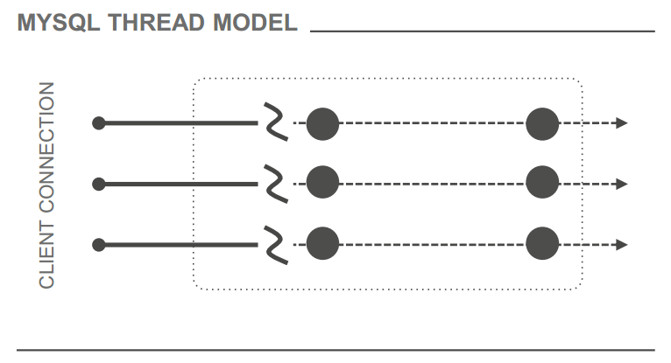
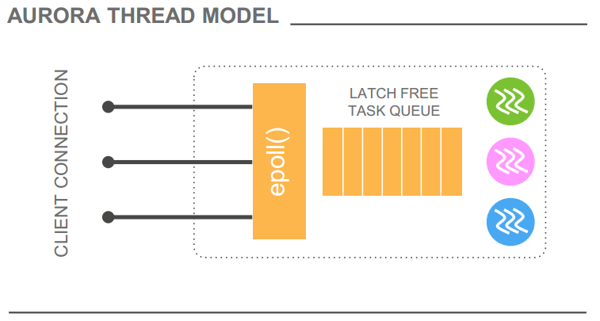
Adaptive thread pool
Standard MySQL – one thread per connection Doesn’t scale with connection count MySQL EE – connections assigned to thread group Requires careful stall threshold tuning
Re-entrant connections multiplexed to active threads
Kernel-space epoll() inserts into latch-free event queue Dynamically size threads pool Gracefully handles 5000+ concurrent client sessions on r3.8xl

Slide 24
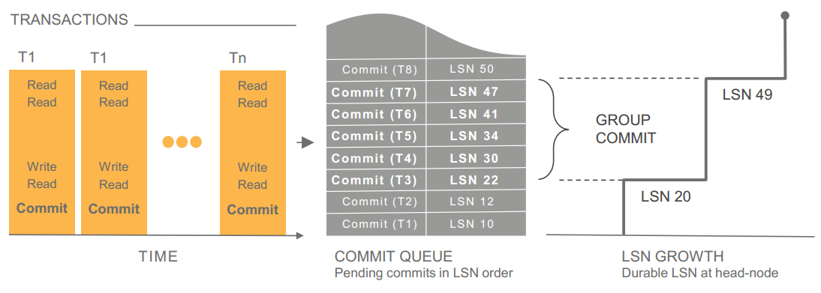
Group Commit
AMAZON AURORA
Request IO with first write
Fill buffer till write picked up
Individual write durable when 4 of 6 storage nodes ACK
Advance DB Durable point
TRADITIONAL APPROACH
Log Buffer
Force when buffer full or timeout
Throughput > Latency

Slide 25
Reads
Read Quorum
Vr > V - Vw
Do not write out pages on eviction (or anywhere else)
Buffer cache always be of the latest version
Evicting a page from the cache only if its “page LSN” is greater than or equal to the VDL.
This protocol ensures that:
(a) All changes in the page have been hardened in the log,
(b) On a cache miss, it is sufficient to request a version of the page as of the current VDL to get its latest durable version.
When reading a page from disk, the database establishes a read-point
Representing the VDL at the time the request was issued.
Log shipped from the writer instance in MTR chunks
Log must be applied atomically in MTR chunks in LSN order

Slide 26
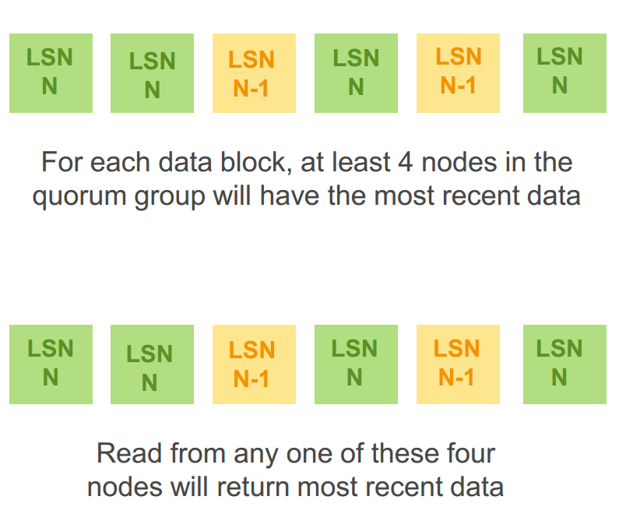
Avoiding Quorum Reads
Reads are expensive in most quorum-based systems
Aurora knows which nodes are up to date, latency to each node
Read quorum only needed for repairs or crash recovery

Slide 27
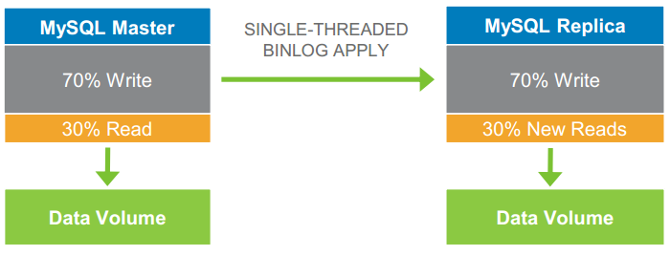
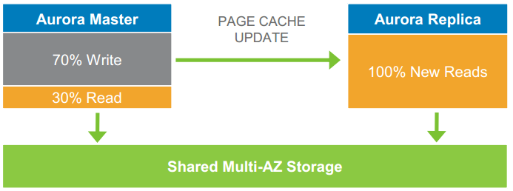
MySQL VS Aurora read scaling
Logical:
Ship SQL statements to Replica
Write workload similar on both instances Independent storage Can result in data drift between Master and Replica
Physical:
Ship redo from Master to Replica Replica shares storage
No writes performed Cached pages have redo applied Advance read view when all commits seen

Slide 28
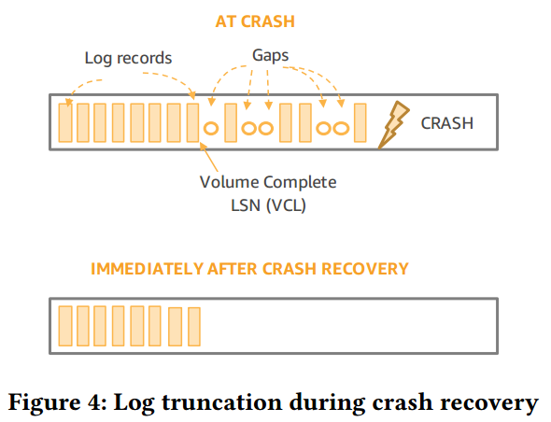
Recovery
Commits are more common than crashes
Reconstruct PGCLs and VCL from local SCL
Truncate log using VCL
Repair from read quorum if write quorum is unable to establish
Increments an epoch in its storage metadata if the volume is available for reads and writes again

Slide 29
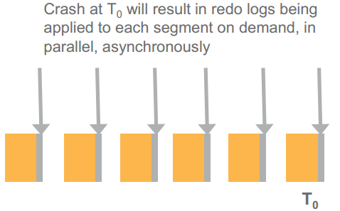
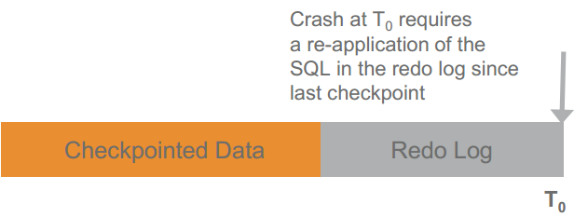
Recovery
Traditional Databases
Have to replay logs since the last checkpoint
Typically 5 minutes between checkpoints
Single-threaded in MySQL; requires a large number of disk accesses
Amazon Aurora
Underlying storage replays redo records on demand as part of a disk read
Parallel, distributed, asynchronous
No replay for startup

Slide 30
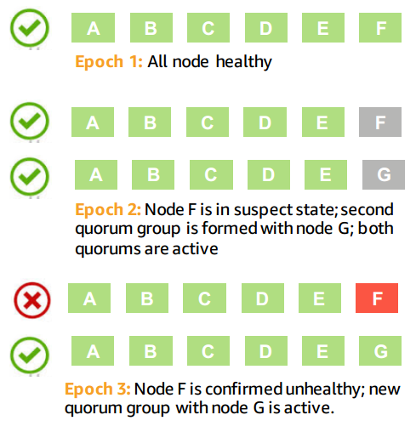
Using Quorum Sets to Change Membership
Using Quorum Sets to Change Membership
Each membership change to a protection group is associated with a membership epoch
No stalls, AZ + 1 fault-tolerance, can aggressively detect failure

Slide 31
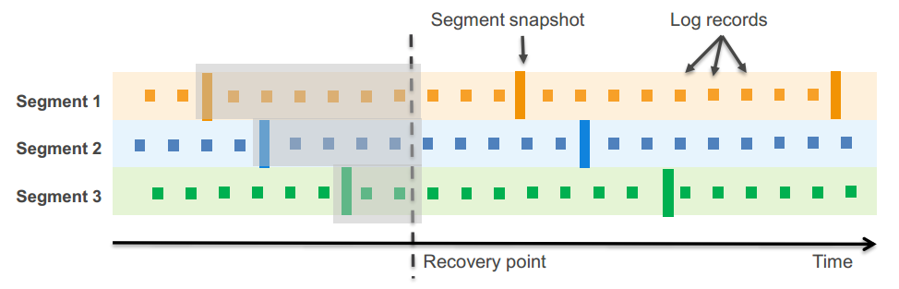
Continuous Backup and Point-in-Time Restore
Take periodic snapshot of each segment in parallel; stream the redo logs to Amazon S3
Backup happens continuously without performance or availability impact
At restore, retrieve the appropriate segment snapshots and log streams to storage nodes
Apply log streams to segment snapshots in parallel and asynchronously

Slide 32
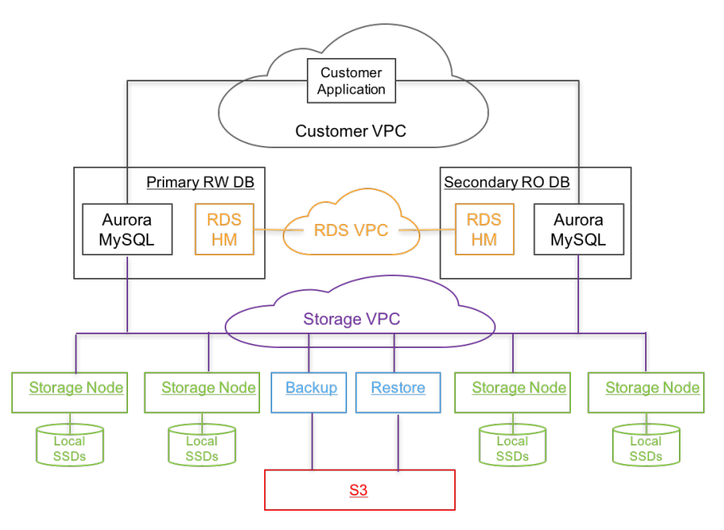
Putting it all together
Database engine is a fork from “community” MySQL
Unified view of storage is logically identical to local storage
Relational Database Service (RDS)
Control plane: Manage metadata
Host manager embedded in for monitoring
A single writer and multiple read replicas
One region, cross AZ
Three layers of Virtual Private Cloud (VPC)
Storage service deployed on EC2 clusters
S3 and DynamoDB for backup

Slide 33
Multi-Master

Slide 34
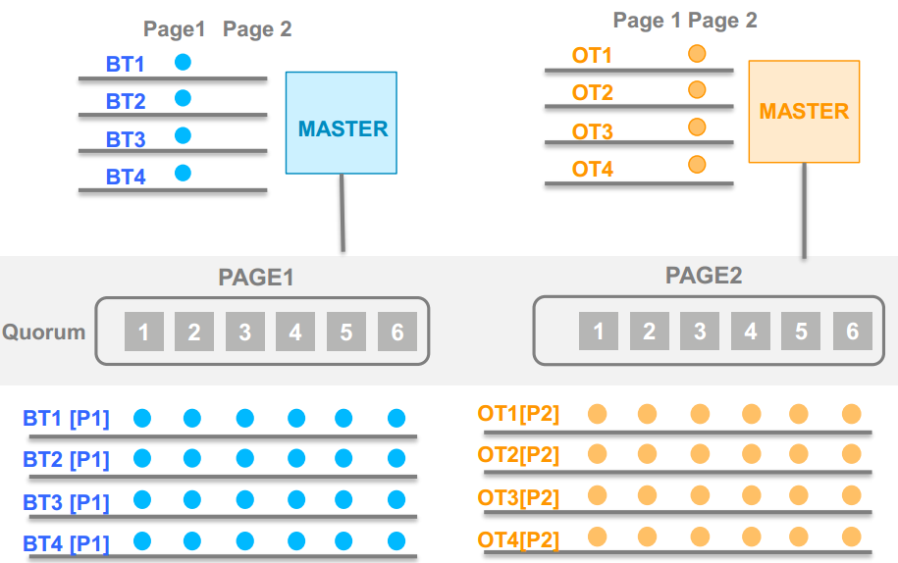
Conflict Resolution using Distributed Ledgers
There are many “oases” of consistency in Aurora
The database nodes know transaction orders from that node
The storage nodes know transaction orders applied at that node
Only have conflicts when data changed at both multiple database nodes AND multiple storage nodes
Much less coordination required

Slide 35
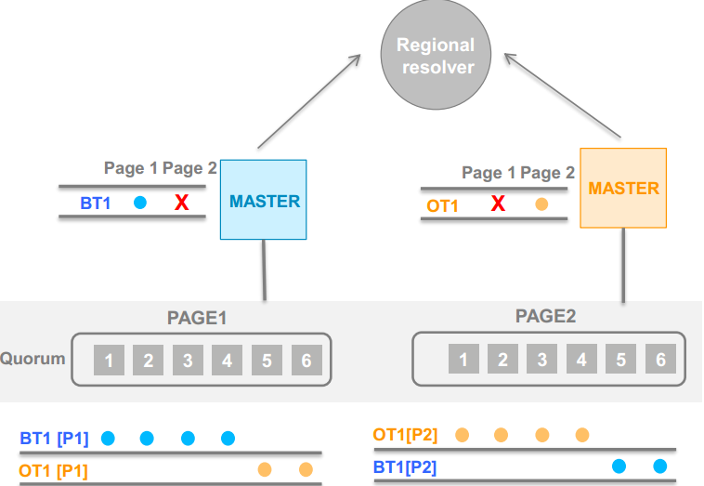
Hierarchical conflict resolution
Both masters are writing to two pages P1 and P2
BLUE master wins the quorum at page P1;
ORANGE master wins quorum at P2
Both masters recognize the conflict and have two choices:
(1) roll back the transactions
(2) escalate to regional resolver
Regional arbitrator decides who wins the tie breaker

Slide 36
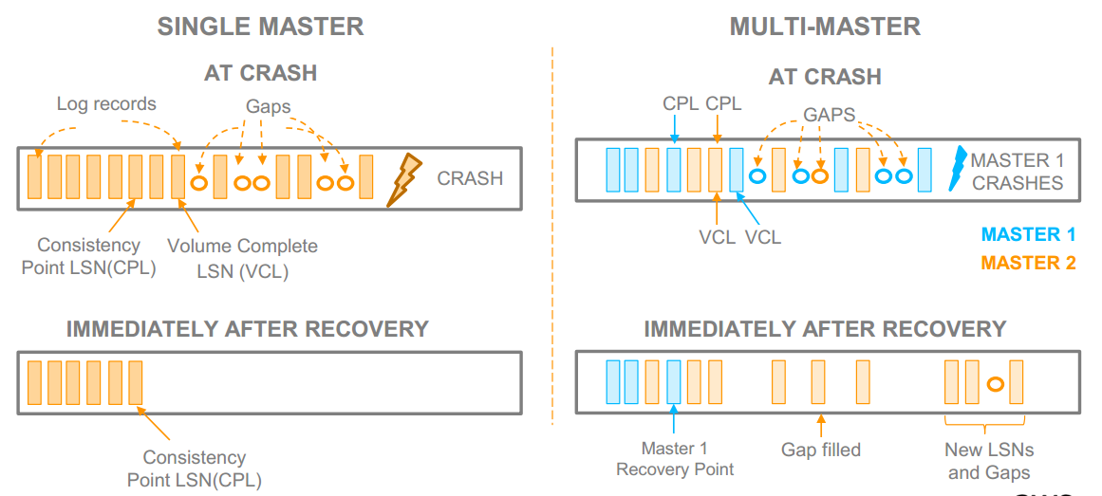
Crash recovery in multi -master

Slide 37
Evaluation
Standard Benchmarks Setups
MySQL 5.6 & MySQL 5.7
r3.8xlarge EC2 instances with 32 vCPUs and 244GB of memory if not specify
Attached EBS volume with 30K provisioned IOPS
Buffer cache set to 170GB
Benchmarks: SysBench & TPC-C

Slide 38
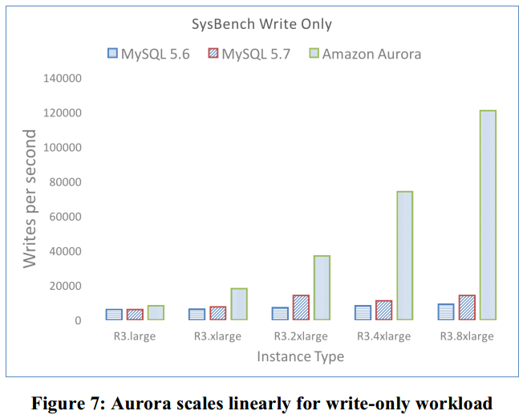
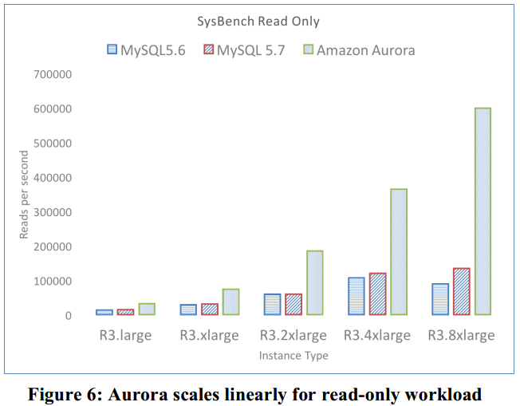
Scaling with instance (Aurora vs MySQL)
> 5x of MySQL
Aurora can scale up linearly while MySQL cannot

Slide 39
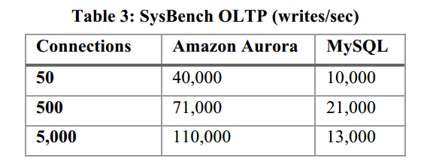
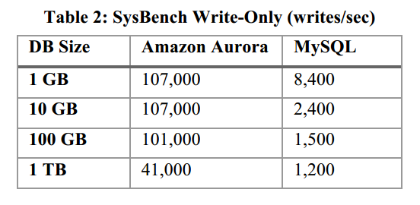
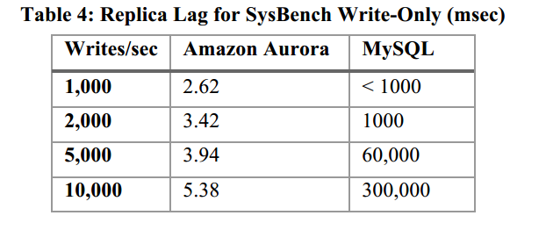
Scaling with DB Size, Connections, Replica Lag
67x
34x
several orders of magnitude smaller

Slide 40
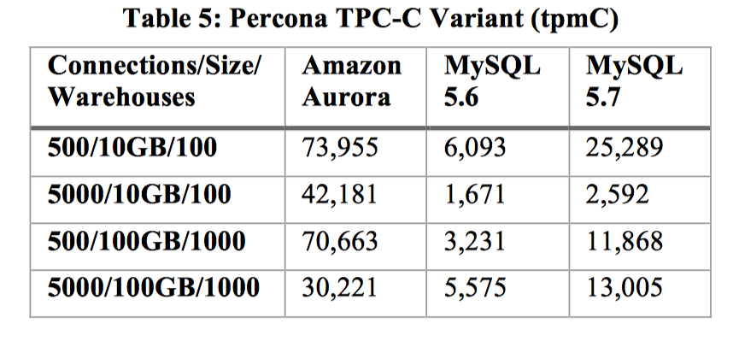
Throughput with hot row contention
Throughput 2.3x to 16.3x compare to MySQL
16.3x
2.3x

Slide 41
Evaluation
Real World Workloads
Internet Gaming
Education

Slide 42
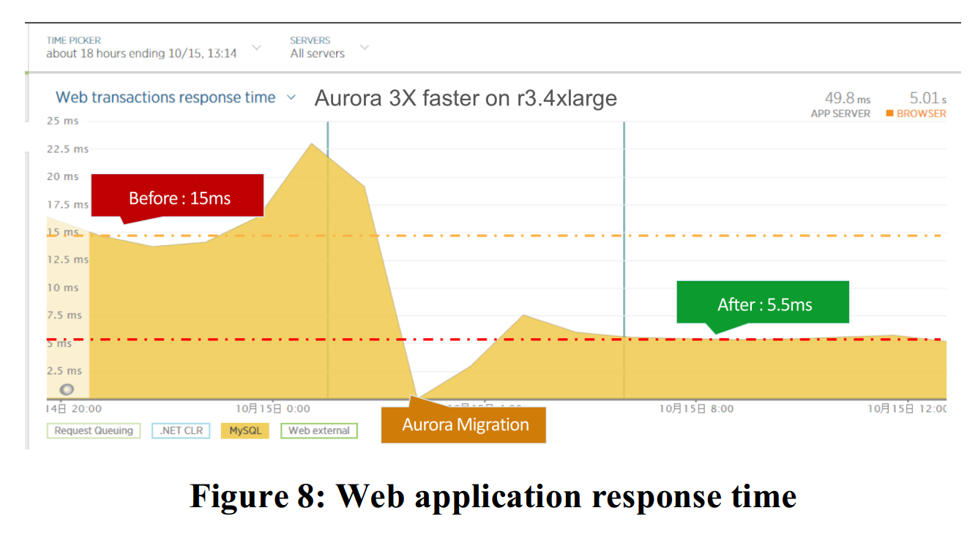
Application Response Time
An internet gaming company
Average response time for web transaction:
15 ms -> 5.5 ms after migration to Aurora

Slide 43
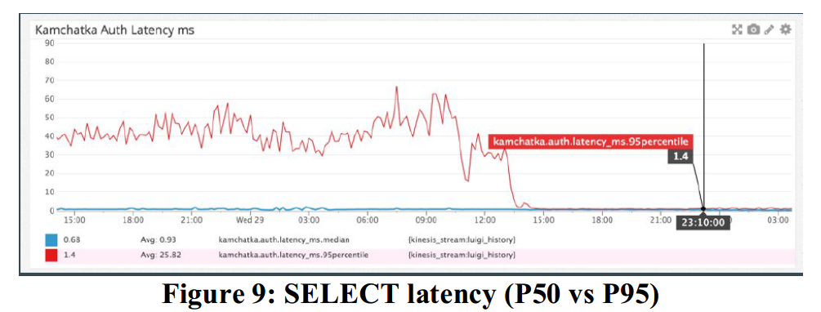
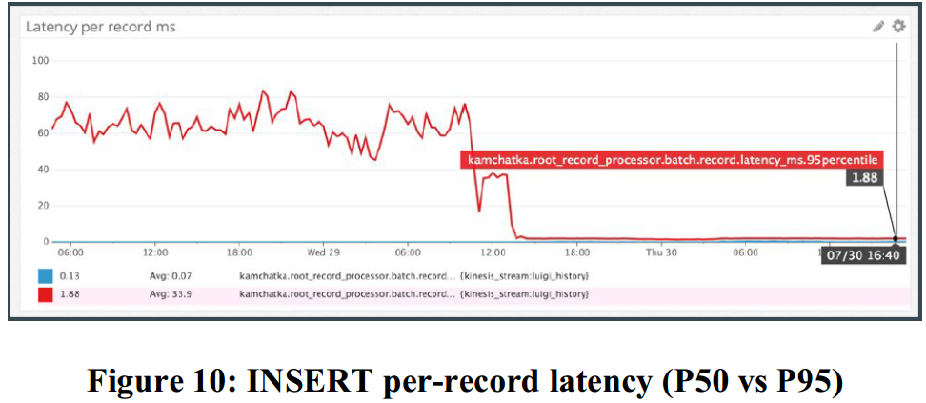
Statement Latencies
An education technology company
After migration to Aurora,
The P95 latency is almost equal to P50 latency

Slide 44
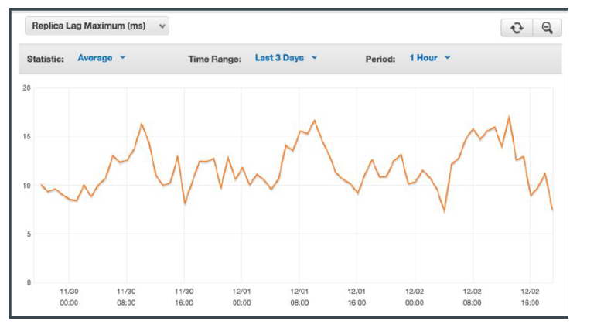
Replica Lag with Multiple Replicas
MySQL
often spiked to 12 minutes
Aurora
never exceeded 20ms

Slide 45
Lessons Learned
Designed for Cloud
Availability && Performance

Slide 46
Reference
Alexandre Verbitski, Anurag Gupta, Debanjan Saha, Murali Brahmadesam, Kamal Gupta, Raman Mittal, Sailesh Krishnamurthy, Sandor Maurice, Tengiz Kharatishvili, Xiaofeng Bao:Amazon Aurora: Design Considerations for High Throughput Cloud-Native Relational Databases. SIGMOD Conference 2017: 1041-1052
Alexandre Verbitski, Anurag Gupta, Debanjan Saha, James Corey, Kamal Gupta, Murali Brahmadesam, Raman Mittal, Sailesh Krishnamurthy, Sandor Maurice, Tengiz Kharatishvili, Xiaofeng Bao:Amazon Aurora: On Avoiding Distributed Consensus for I/Os, Commits, and Membership Changes. SIGMOD Conference 2018: 789-796
https://amazonaws-china.com/cn/rds/aurora/details/
https://www.percona.com/live/17/sessions/amazon-aurora-deep-dive-whats-new#speakers
https://www.slideshare.net/AmazonWebServices/deep-dive-on-amazon-aurora-88363686

Slide 47
Thank You !

